Slide 1
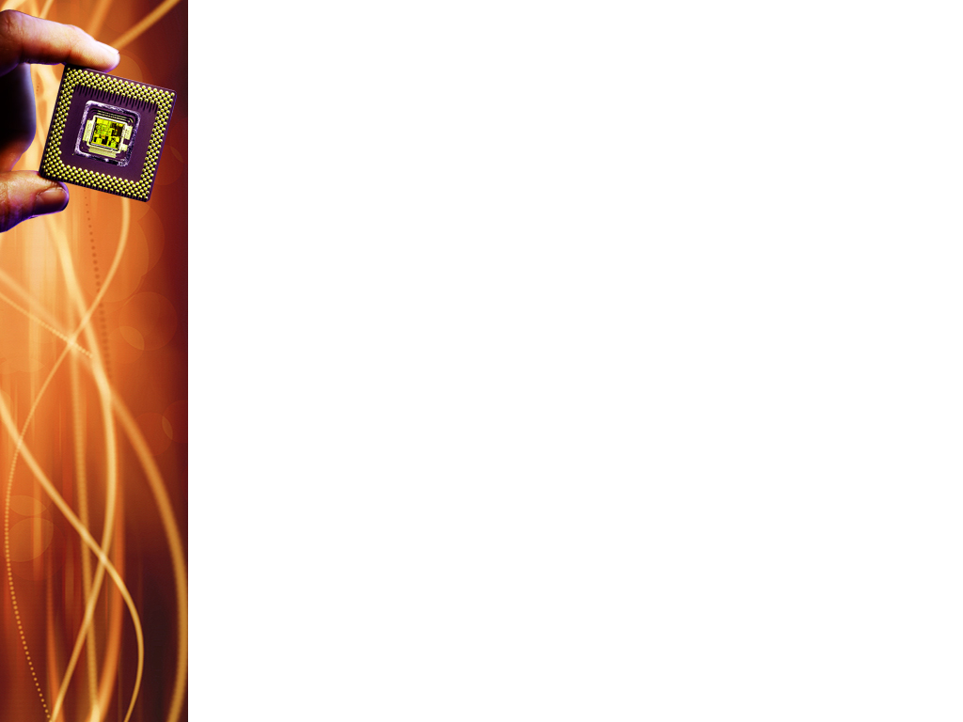
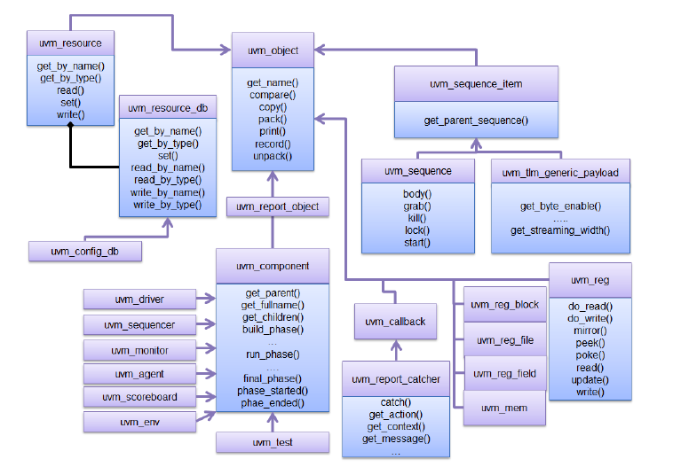
UVM Class diagram - Review

Slide 2
Reset Handling
Challenges in handling of hardware resets in a verification environment:
Reset has to be propagated to all testbench components
All UVM components such as driver, monitor, scoreboard must be capable of reacting to the reset (reset aware)
All pending sequences already scheduled by the test must be removed from all sequencers and virtual sequencers
Once the system gets out of reset, the traffic must be re-generated to the DUT.

Slide 3
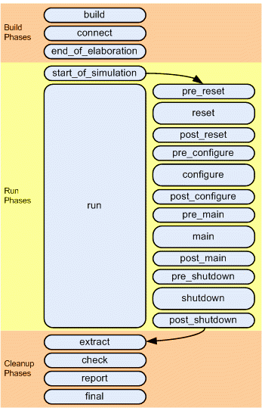
Reset Handling
Notes:
The run phase is partitioned into 12 sub-phases, all being tasks in nature (time is consumed by these sub-phases).

Slide 4
Reset Handling
pre-reset:
Starts at the same time as run phase.
Takes care of any activity that should occur before reset(eg: waiting for power signal to go active)
reset:
Used to generate reset to put the DUT/interface into a default state
post_reset:
For any activity required just after the reset phase.

Slide 5
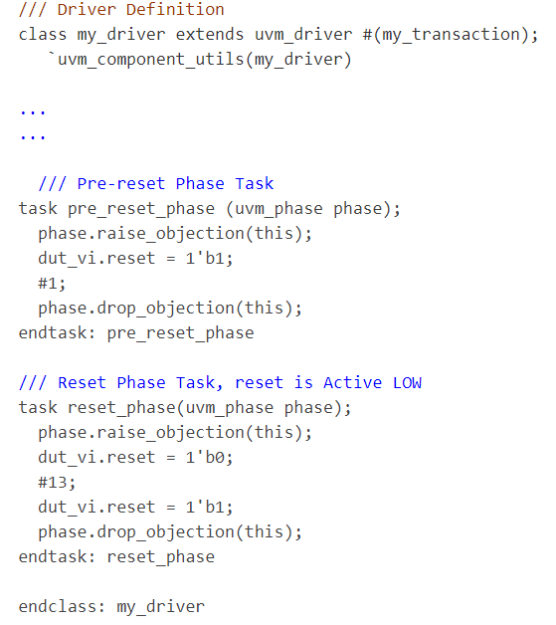
Notes:
In this UVM driver code example, dut_vi is the virtual interface declaration that is made inside the driver. Inside the reset_phase, the reset signal (dut_vi.reset) will be driven LOW to assert the reset and after some time (13 ns) the reset signal is driven HIGH to de-assert the reset and the DUT will be out of reset at this point.

Slide 6
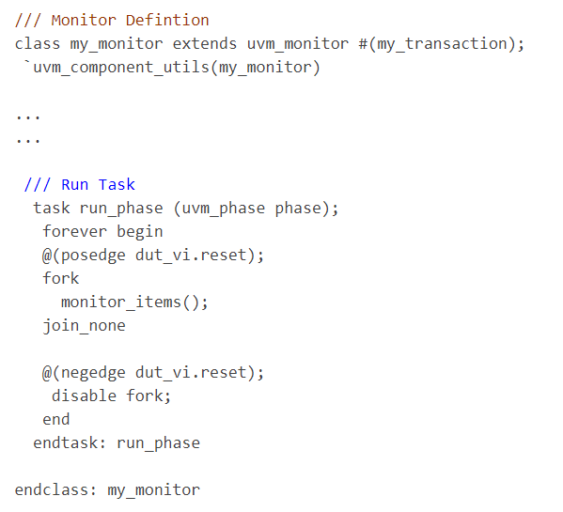
Reset Handling for Monitor
Notes:
Monitor is present in a uvm agent (regardless of active or passive), and receives the pin-level interface signals, after which it transforms these signals into transaction objects. So, as soon as reset signal is asserted, monitor should disable the process of data collection from the interfaces.
Multiple/Intermediate reset
On power ON, a reset is generated. But, there may be test scenarios where you may want to reset the DUT after the 1st sequence is over, and run the same or different sequence to test DUT behavior without getting it to power down. So, a new reset is triggered without coming out of the UVM phases.
In this example, in the run_phase task forever loop, monitor_items() task is waiting for dut_vi.reset signal positive edge (reset is de-asserted for active LOW reset). Once the condition is met, monitor_items is spawned from the fork..join_none and the monitor starts collecting the transactions. If there is an upcoming or intermediate reset that comes in the negedge of dut_if.reset (active LOW), the fork process is disabled and monitor_items task is stopped. This is what is expected when a reset occurs (no transactions are collected from input or output ports).

Slide 7
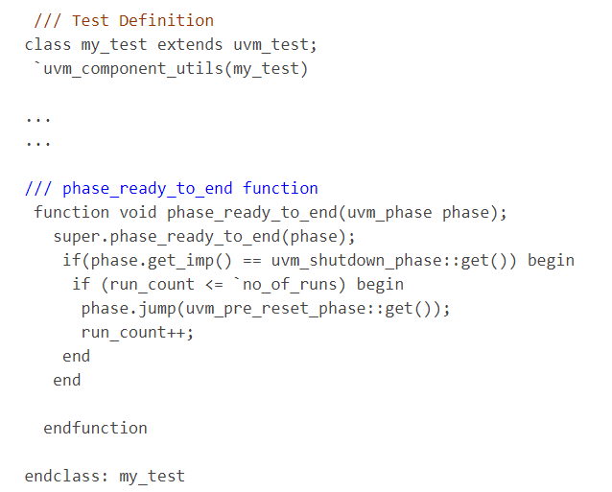
Reset Handling in Sequencer
Notes:
In UVM, the Test ending mechanism is via Raise Objections and Drop Objections. So the indication of finishing a Sequence is that all the Raised Objections are Dropped and the Objection counter value will be zero at this point. Now phase_ready_to_end() function defined above comes into action. phase_ready_to_end() is called whenever the total objection count for the current phase decrements to 0.
From the above code, its clear that once the phase is shutdown_phase (which is last Sub-phase out of the 12 Run Sub-phases) & there is no pending Objection, phase_ready_to_end is activated and make a JUMP to the pre_reset_phase(). From there on, the whole cycle is repeated. This way, the whole process is re-started again & a new RESET is generated.
This approach can be further extended to Test the scenario where Reset is triggered in-between of the Sequence execution instead of after completing the Sequence.
Whenever there is a UVM phase JUMP instruction, all ongoing transactions are stopped and the internal FIFOs that are involved in holding the running transactions on that sequencer are cleared.

Slide 8
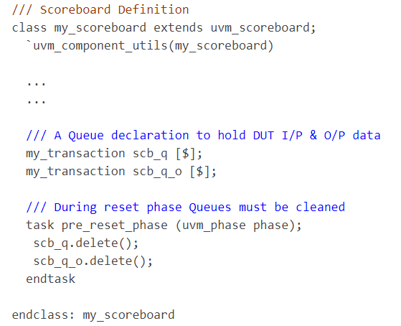
Reset Handling in Scoreboard
Notes:
Usually, queues are used inside SB to hold the incoming stream of data transactions. Upon reset, the queues inside the SB must be cleared and all existing elements need to be flushed out. SB doesn’t have any direct access to the interface, it works with UVM analysis imports and deals with transaction objects. Queues can be flushed out in pre_reset_phase().

Slide 9
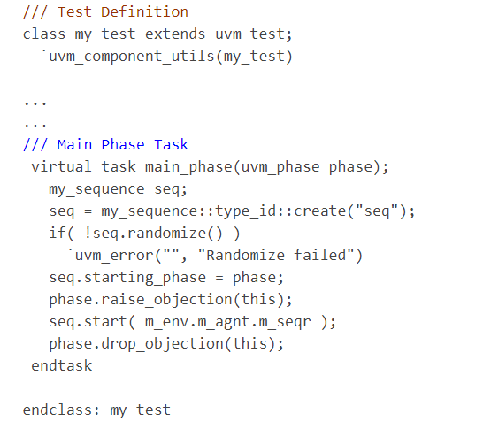
Reset Handling in Sequence
Notes:
Sequence is the dynamic that generates stimulus for DUT. In terms of multiple reset handling, sequence must be stopped once reset is asserted and must be restarted automatically upon de-assertion of reset.
In this example, sequence is started on the sequencer m_seqr once the main_phase is entered. So, if we’re able to recycle the UVM phasing flow, sequence will be automatically started on the defined sequencer.

Slide 10
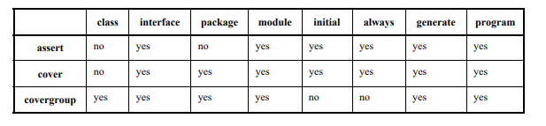
Implementing coverage & checks
Notes:
For a coverage-driven verification, checks and coverage are required. The table depicts SV checks and coverage construct usage.
Checks and coverage can be defined in multiple locations based on category of functionality being analyzed.

Slide 11
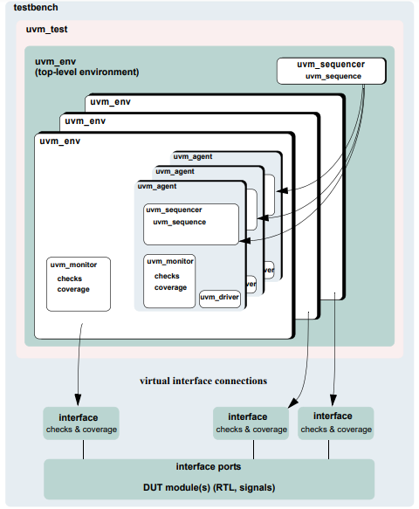
Notes:
Here, checks and coverage are depicted in uvm_monitor and interface

Slide 12
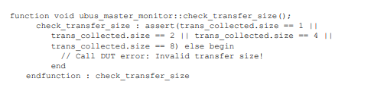
Implementing coverage & checks in classes
Implemented in classes derived from uvm_monitor
Write checks as procedural code or SV immediate assertions
TIP: Use immediate assertions for simple checks (written in few lines of code).
Use functions for complex checks (many lines of code)
Notes:
As checks become more complicated, so does their debugging.
Concurrent assertions are not allowed in SV classes.
In the example of an assertion check, the assertion verifies that the size field of the transfer is 1, 2, 4, or 8. Otherwise, the assertions fails.

Slide 13


This is procedural-code example of a check.
Execution of checks by call to the check functions.
Notes:
The first example is a functional check that verifies the size field value matches the size of the data dynamic array.
The proper time to execute checks is implementation-dependent. In this example, both checks must be implemented after the transfer is collected by the monitor. Since these checks happen at the same instance of time, a wrapper function is created so that only one call has to be made. The perform_transfer_checks function is called procedurally after the item has been collected by the monitor.

Slide 14
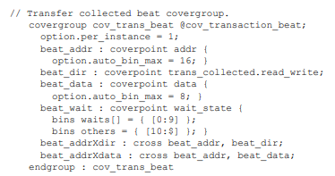
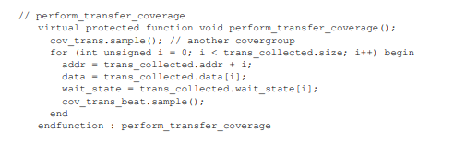
Notes:
Functional coverage is implemented using SV covergroups. Details of the covergroup (coverpoints, when to sample coverage, what bins to create) must be planned and decided prior to start of implementation. The first example shows a simple covergroup. This embedded covergroup is defined inside a class derived from uvm_monitor. For the covergroup, assign local variables that serve as coverpoints in a function, then sample the covergroup. This is for each transaction data beat of the transfer to be covered.
The second example shows the function. The function covers several properties of the transfer, with each element of the dynamic array data. SV doesn’t provide ability to cover dynamic arrays. Each element must be accessed individually to cover that value, if required.

Slide 15
Implementing Coverage & Checks in Interfaces
Checks implemented as assertions
Assertions related to physical interface are placed in env’s interface
Assert is used when the property expresses behavior of DUT
Assume is used when the property expresses behavior of the environment that generates stimulus to DUT
Notes:
Assertions are added to check signal activity for a protocol.
Assert along with assume properties are used to express interface checks.

Slide 16
Controlling coverage and checks
If checks_enable is 0, the function that performs the checks is not called.
Notes:
There must be some means to control whether checks are enforced and coverage is collected. The UVM bitfield is used for this purpose, which is controlled using the uvm_config_db.
Similar to checks_enable, even coverage_enable field can be used in the monitors.

